Slide 1


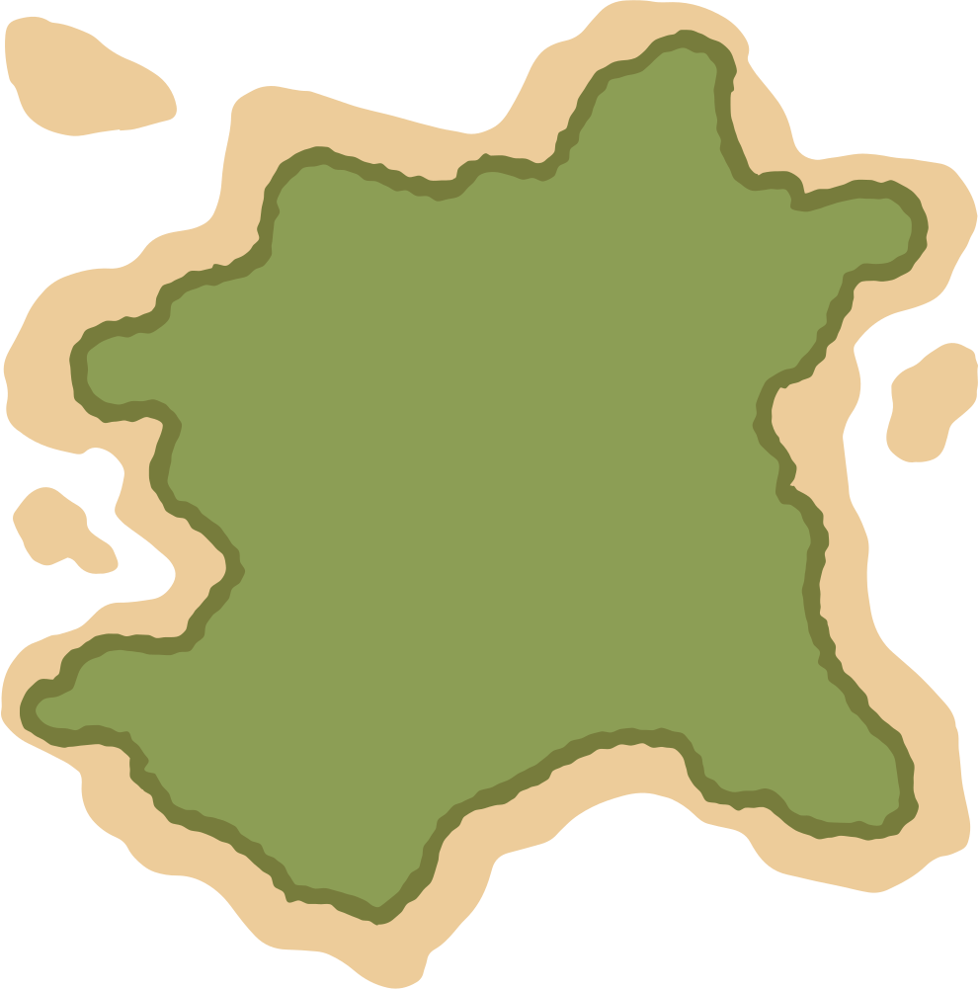


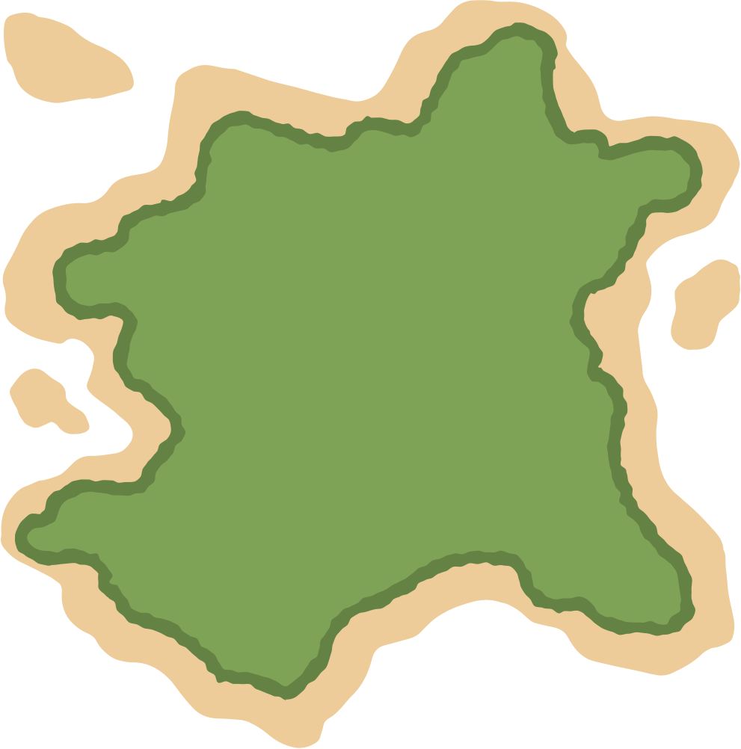
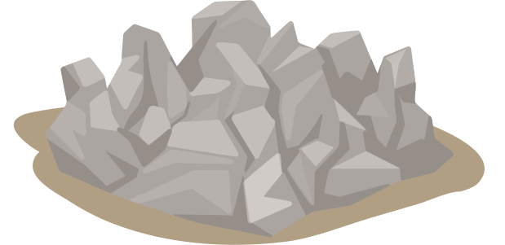





Polpo's Paradise
"Your Coordinates, Your Control:
Navigate with Precision"
KUSOSCM's Infinity CodeWave
24 Hr. Hackathon
Friday 25 August 2023

Slide 2




KUSOECE'20
Polpo's Paradise
Team Members
ROSHAN
SAHANI
SAMIKSHYA
UPADHYAY
REEWAJ
KHANAL

Slide 3
Problem Statement
It is estimated that 2 billion people in the world lack physical address. In attempt to change that multiple efforts have been employed. A recurring idea is the street based metric addressing system. However this system develops long address which even though are descriptive, are difficult to communicate.

Slide 4
Brainstroming Problem
Longitude
&
Latitude
Grid Map View
Refrencing
Buildings and Other Items
Use & Manipulate
Geospatial Data
Layman
Understandable Address
Futuristic
Approach for Address
Intuitive
Naming
Hash that
Trash

Slide 5
Objectives
Primary
Secondary
"Create a system that adapts to users' preferences for sharing their locations while maintaining ease of use and accuracy."
Integration with Services
Cross-Platform Compatibility
GIS Integration
Sustainability

Slide 6
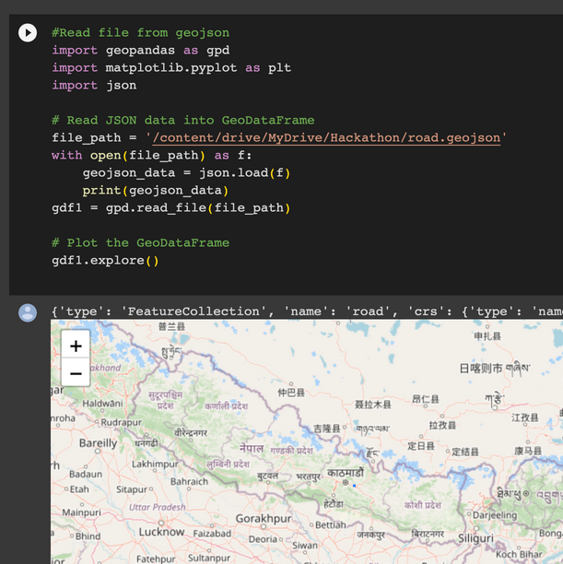



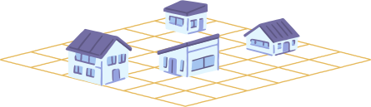
How did we start our project?
Initiated by a day-long brainstorming session guided by NAXA mentors, our project crystallized a seamless algorithm utilizing GeoJSON data, driven by logical relations and innovative problem-solving strategies.

Slide 7



What do we expect from our project?
Clarity
Localization
Efficiency
Uniqueness
Scalability
Uniformity

Slide 8




What is our the start point of our algorithm?
Use & Manipulate
Geospatial Data
GPS Coordinates
GIS [Geographic Information System] Maps
Satellite Imagery
Aerial Imagery
Address Data
Remote Sensing Data
Map, Grid and Address
Regular Map
Grid Map
Grid 1 : G1

Slide 9
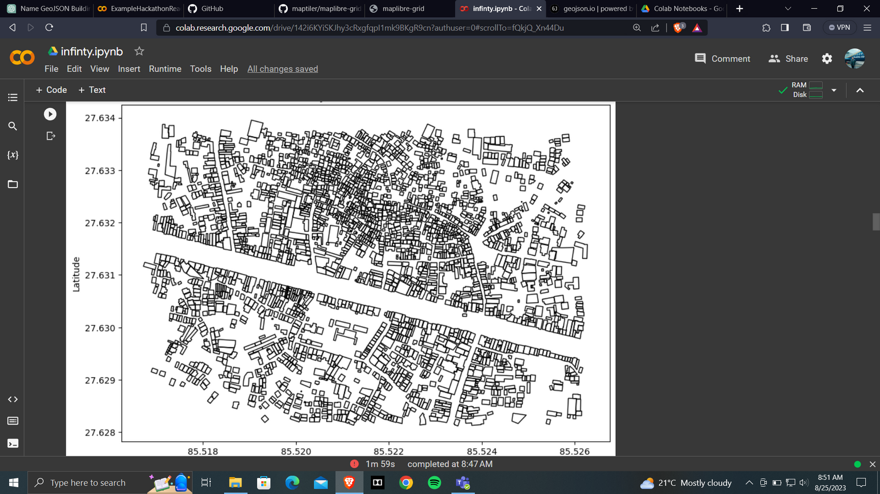
Imported .geojson map file

Slide 10
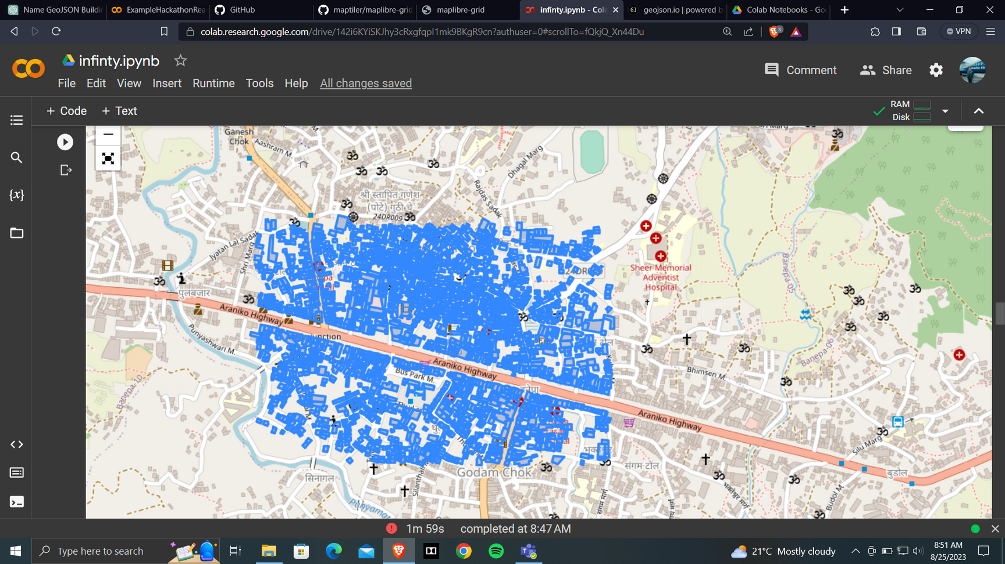
Integration .geojson map file with OSM Map

Slide 11
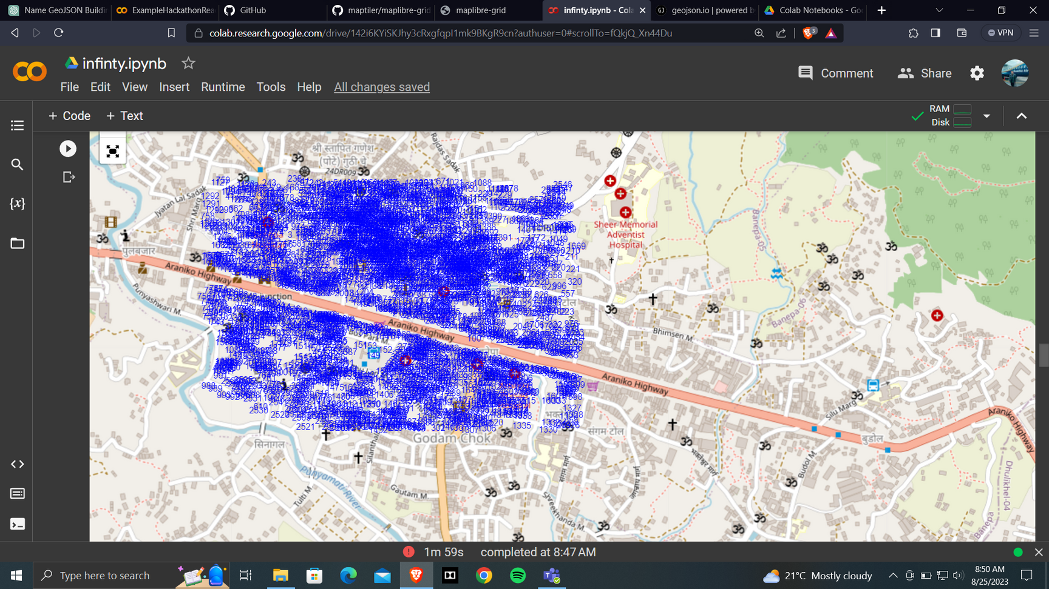
Naming buildings from our algorithm

Slide 12
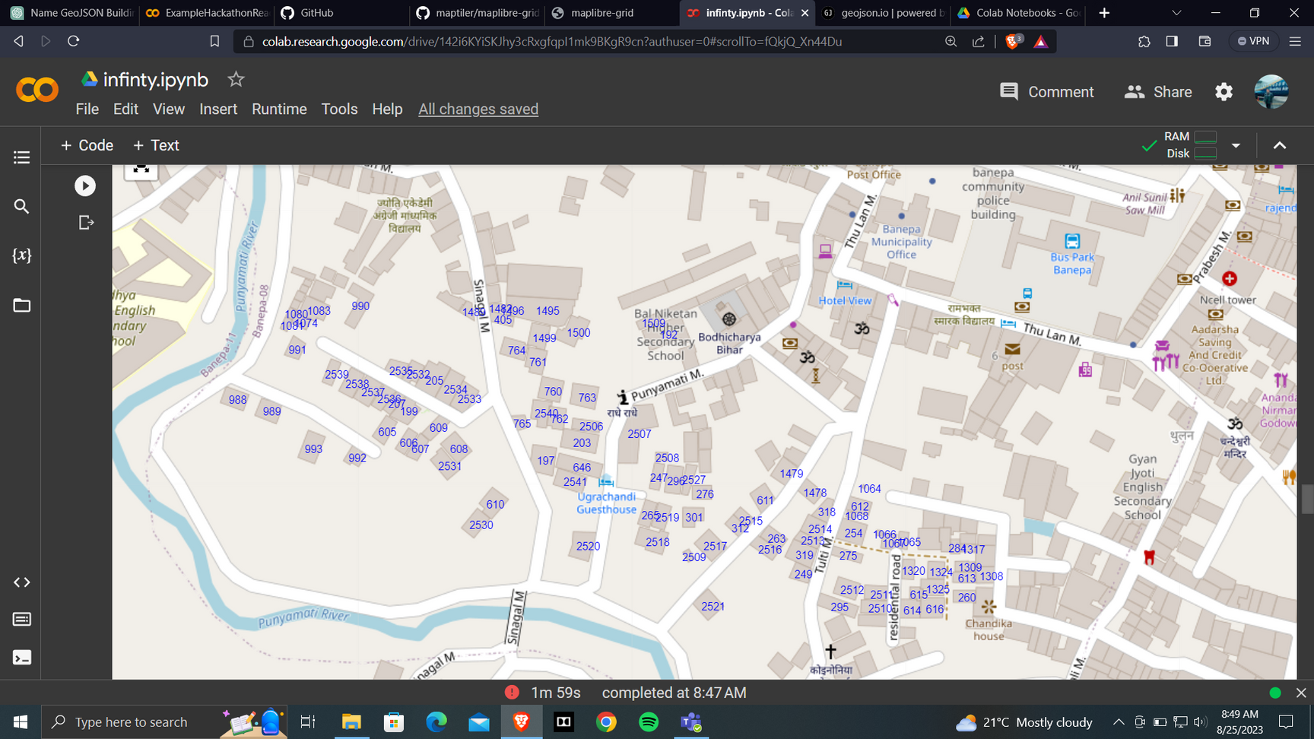
Working on fewer protypes of house data

Slide 13
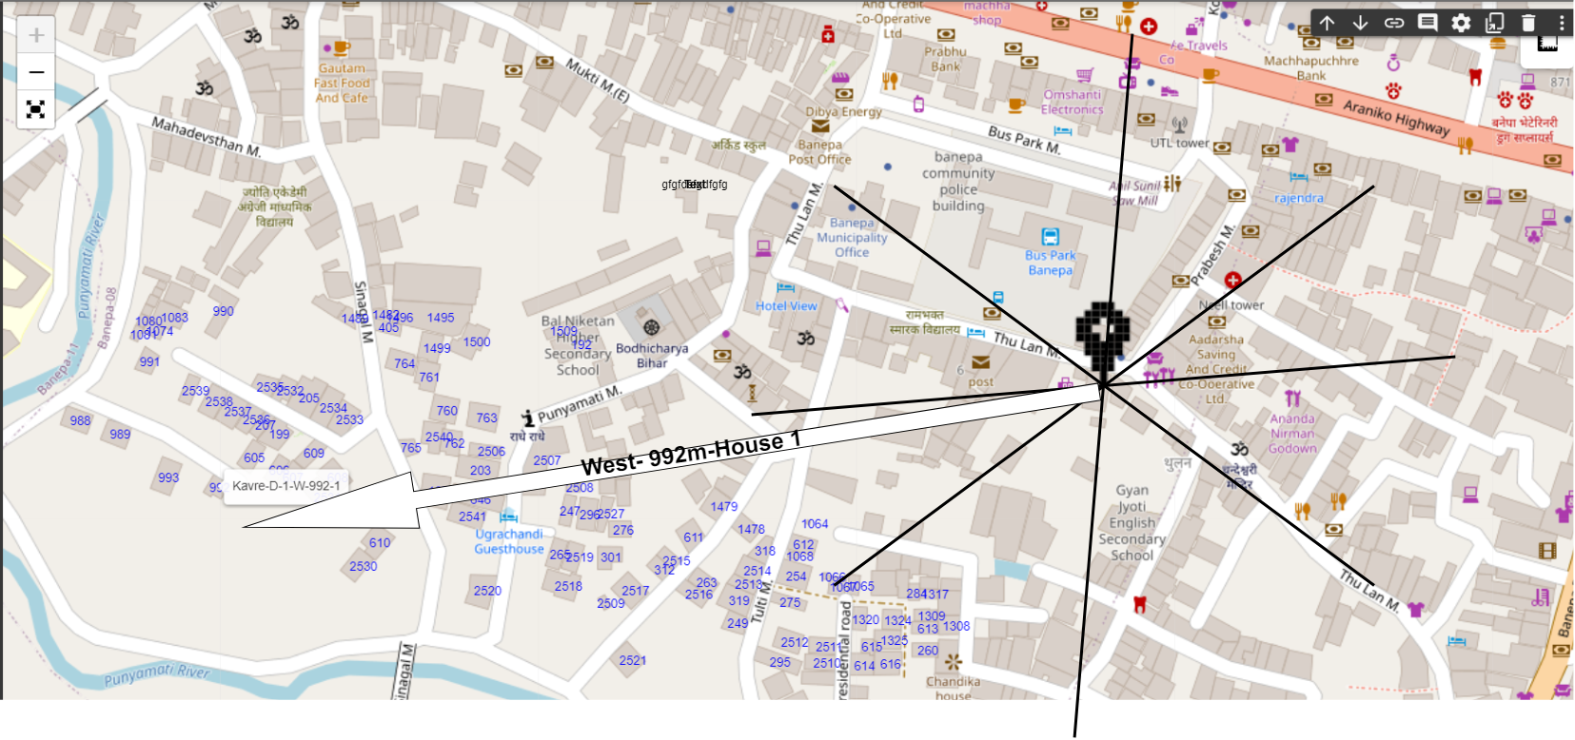
Naming a particular from our algorithm

Slide 14
What is our Algorithm?
- Import world map.
- Extract national boundary.
- Extract provincial boundary.
- Obtain district boundary.
- Define precise Rural/Municipal or Sub/Metropolitan boundaries.
Mapping Procedure
(Open Naming)
- Establish central Permanent Bench Mark in each ward using GPS technology
with a precise compass engraved.
- Obtain directional reference from Permanent Bench Mark using compass
divisions.
- Utilize directional guidance and metric distance from reference point for
additional navigation.

Slide 15
- Employing the open naming algorithm for private addresses.
- Initiating navigation from the Permanent Bench Mark (PBM) using cardinal
directions (including sub-directions).
- Structured hashing:
District: D [Example: Kavrepalanchowk - K]
Municipality/RuralMunicipality/Metropolitan/Sub-Metropolitan: M
Ward No: Wn
East-West Direction from PBM: NS
Distance from PBM: m
House number: A1
- Generating the hash code: D-M-Wn-NS-mm-A1.
Mapping Procedure
(Private Naming)

Slide 16
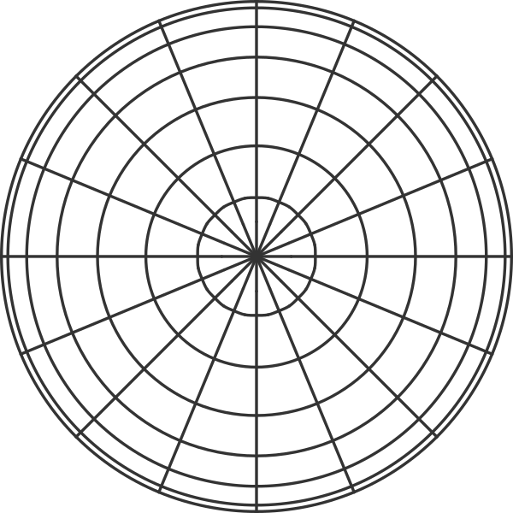



How do we name house?
NW
NE
distance in meter
SW
SE

Slide 17
Futuristic Approach
NW
NE
distance in meter
SW
SE

Slide 18

WORK FLOW
Start
Determine the District Name
Determine Municipality Name
Private :
District Name-Municipality/Rural Municipality/Metropolitan/Sub-Metropolitan - Ward No-Landmark Direction-Distance- House No
Public :
District Name + Municipality/Rural Municipality/Metropolitan/Sub-Metropolitan+Ward No+ Landmark + Direction + Distance
Identify the Ward No
GPS PBMS in center of each ward
Estimate the direction
Measure distance from Landmark
Determine House no if shared
Hash Code
D-M-Wn-NS-m(A1)
Eg: Kavre-D-4-E-800(15)
Compose Unique House Address
Stop

Slide 19
Thank You !
GitHub Link:
https://github.com/felixop7/Polpos-Paradise

